Slide 1
Trees
Mrs. Sonali V. Shinge

Slide 2
A tree is a non-linear abstract data type with a hierarchy-based structure.
Tree data structure is a hierarchical structure that is used to represent and organize data in the form of parent child relationship.
The topmost node of the tree is called the root, and the nodes below it are called the child nodes.

Slide 3
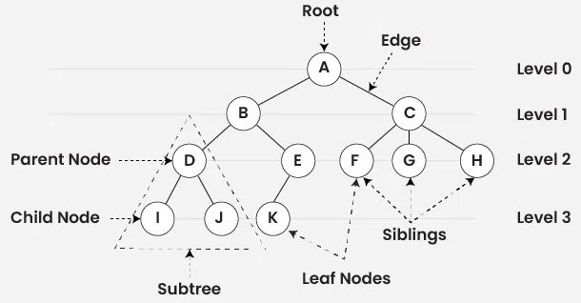

Slide 4
Basic Terminologies In Tree Data Structure
Parent Node: The node which is an immediate predecessor of a node is called the parent node of that node.
Child Node: The node which is the immediate successor of a node is called the child node of that node.
Root Node: The topmost node of a tree or the node which does not have any parent node is called the root node.
Leaf Node or External Node: The nodes which do not have any child nodes are called leaf nodes.

Slide 5
Ancestor of a Node: Any predecessor nodes on the path of the root to that node are called Ancestors of that node.
Descendant: A node x is a descendant of another node y if and only if y is an ancestor of x.
Sibling: Children of the same parent node are called siblings.
Level of a node: The count of edges on the path from the root node to that node. The root node has level 0.

Slide 6
Internal node: A node with at least one child is called Internal Node.
Neighbour of a Node: Parent or child nodes of that node are called neighbors of that node.
Subtree: Any node of the tree along with its descendant.
Path : Path refers to the sequence of nodes along the edges of a tree.

Slide 7
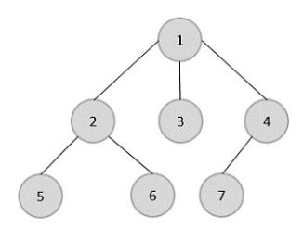
Types of Trees
General Trees
Binary Trees
Binary Search Trees
1. General trees are unordered tree data structures where the root node has minimum 0 or maximum n subtrees.

Slide 8
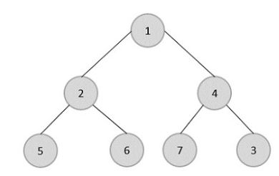
2. Binary Trees: Binary Trees are general trees in which the root node can only hold up to maximum 2 subtrees: left subtree and right subtree.

Slide 9
Full Binary Tree : A full binary tree is a binary tree type where every node has either 0 or 2 child nodes.
Complete Binary Tree: A complete binary tree is a binary tree type where all the leaf nodes must be on the same level. However, root and internal nodes in a complete binary tree can either have 0, 1 or 2 child nodes.
A complete binary tree is just like a full binary tree, but with two major differences:
Every level except the last level must be completely filled.
All the leaf elements must lean towards the left.
The last leaf element might not have a right sibling i.e. a complete binary tree doesn’t have to be a full binary tree.

Slide 10
3. Perfect Binary Tree: A perfect binary tree is a binary tree type where all the leaf nodes are on the same level and every node except leaf nodes have 2 children.
In a Perfect Binary Tree, the number of leaf nodes is the number of internal nodes plus 1
L = I + 1 Where L = Number of leaf nodes, I = Number of internal nodes.
A Perfect Binary Tree of height h (where the height of the binary tree is the number of edges in the longest path from the root node to any leaf node in the tree, height of root node is 0) has 2^{h+1} – 1 node.

Slide 11
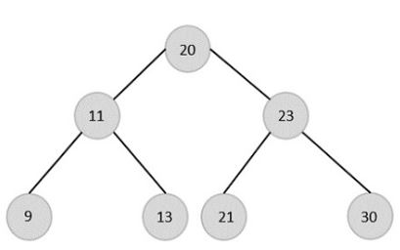
4. Binary Search Trees: Binary Search Trees possess all the properties of Binary Trees including some extra properties of their own, based on some constraints, making them more efficient than binary trees.
The data in the Binary Search Trees (BST) is always stored in such a way that the values in the left subtree are always less than the values in the root node and the values in the right subtree are always greater than the values in the root node.

Slide 12
The main disadvantage of Binary Search Trees is that if all elements in nodes are either greater than or lesser than the root node, the tree becomes skewed. Simply put, the tree becomes slanted to one side completely.
This skewness will make the tree a linked list rather than a BST, since the worst case time complexity for searching operation becomes O(n).
To overcome this issue of skewness in the Binary Search Trees, the concept of Balanced Binary Search Trees was introduced.

Slide 13
Balanced Binary Search Trees
Consider a Binary Search Tree with m as the height of the left subtree and n as the height of the right subtree. If the value of (m-n) is equal to 0,1 or -1, the tree is said to be a Balanced Binary Search Tree.
The trees are designed in a way that they self-balance once the height difference exceeds 1. Binary Search Trees use rotations as self-balancing algorithms. There are four different types of rotations: Left Left, Right Right, Left Right, Right Left.

Slide 14
There are various types of self-balancing binary search trees
AVL Trees
Red Black Trees
B Trees
B+ Trees
Splay Trees
Priority Search Trees

Slide 15
Binary Tree
Properties of Binary Tree
The maximum number of nodes at level L of a binary tree is 2^{L}
The maximum number of nodes in a binary tree of height H is 2^{H} – 1
Total number of leaf nodes in a binary tree = total number of nodes with 2 children + 1
In a Binary Tree with N nodes, the minimum possible height or the minimum number of levels is Log₂(N+1)
A Binary Tree with L leaves has at least | Log2L |+ 1 levels

Slide 16
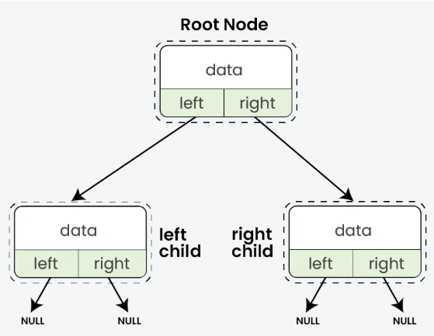

Slide 17
Traversal in Binary Tree
Traversal is a process to visit all the nodes of a tree and may print their values too. Because, all nodes are connected via edges (links) we always start from the root (head) node. That is, we cannot randomly access a node in a tree. There are three ways which we use to traverse a tree-
In-order Traversal
Pre-order Traversal
Post-order Traversal

Slide 18
In-order Traversal
In this traversal method, the left subtree is visited first, then the root and later the right sub-tree.
Algorithm
Traverse the left subtree of R in inorder.
Process the root R.
Traverse the right subtree of R in inorder.

Slide 19
Pre-order Traversal
In this traversal method, the root node is visited first, then the left subtree and finally the right subtree.
Algorithm
Process the root R.
Traverse the left subtree of R in preorder.
Traverse the right subtree of R in preorder.

Slide 20
Post-order Traversal
In this traversal method, the root node is visited last, hence the name. First we traverse the left subtree, then the right subtree and finally the root node.
Algorithm
Traverse the left subtree of R in posteorder.
Traverse the right subtree of R in posteorder.
Process the root R.

